Slide 1
Introduction to Prompt Engineering
What is Prompt Engineering?
Importance in the Chatbot Industry
Role of ChatGPT in Prompt Engineering

Slide 2
Basics of ChatGPT
Overview of ChatGPT
How it works?
Key features and capabilities

Slide 3
Prompt Engineering: Definition
Crafting input prompts for models
Guiding model's response
Optimizing user experience

Slide 4
Why Prompt Engineering?
Improving model reliability
Tailoring responses to specific needs
Enhancing user interaction

Slide 5
Types of Prompts
Explicit prompts
Implicit prompts
Contextual prompts

Slide 6
Explicit Prompts
Directly instructing the model
Example: 'Translate this to French: ...'
Benefits and limitations

Slide 7
Implicit Prompts
Indirect guidance to the model
Example: 'As a historian, explain ...'
Benefits and limitations

Slide 8
Contextual Prompts
Providing context for better understanding
Example: 'In the context of 19th century, describe ...'
Benefits and limitations

Slide 9
Prompt Engineering with ChatGPT
How ChatGPT utilizes prompts?
Customizing ChatGPT's responses
Real-world applications

Slide 10
Challenges in Prompt Engineering
Finding the right balance
Avoiding overfitting to prompts
Ensuring model safety

Slide 11
Overfitting
Overfitting occurs when the model performs well on training data but generalizes poorly to unseen data.
Overfitting is a very common problem in Machine Learning and there has been an extensive range of literature dedicated to studying methods for preventing overfitting
Have clarity while writing prompt, don’t bombard it with too much information.
https://towardsdatascience.com/8-simple-techniques-to-prevent-overfitting-4d443da2ef7d

Slide 12

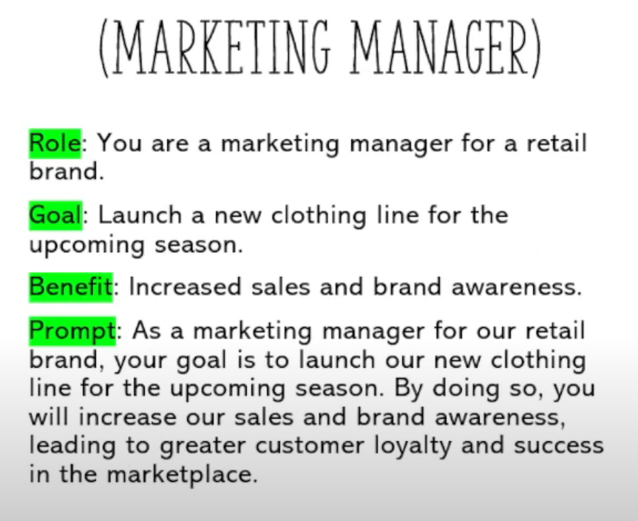
Role Goal Benefit Model

Slide 13
Future of Prompt Engineering
Adaptive prompting
User-specific customization
Integration with other technologies

Slide 14
Case Study: ChatGPT in Customer Support
Using prompts for specific queries
Feedback loop and improvements
Results and impact

Slide 15
Case Study: ChatGPT in Education
Guiding students with prompts
Interactive learning experiences
Benefits and challenges

Slide 16
Tools for Prompt Engineering
Development environments
Testing and validation tools
Community-driven platforms

Slide 17
Best Practices in Prompt Engineering
Iterative testing
User feedback integration
Continuous learning and adaptation

Slide 18
Best Practices
Here are some practical tips for using ChatGPT prompts effectively:
Be clear and specific: When entering your prompt, be as clear and specific as possible about what you want to ask about or discuss. This will help ChatGPT understand your question and generate a more relevant and useful response.
Use complete sentences: ChatGPT works best when it is given complete sentences or questions. Don't use incomplete sentences or shorthand, as this can confuse the AI and make its answers less accurate.
Use natural language: ChatGPT is designed to understand natural language, so try to use conversational language when interacting with it. Avoid using overly formal or technical language, which can be more difficult for the AI to understand.

Slide 19
Best Practices
Provide context: When entering a prompt, provide any relevant context or background information that may be helpful for ChatGPT to understand the question or topic at hand.
Use multiple prompts: If you're not satisfied with the response you receive, try entering a different prompt or rephrasing your question. ChatGPT's responses are generated based on the input it receives, so sometimes changing the prompt can lead to more useful and accurate responses.
Use prompts to explore ideas: ChatGPT can be a helpful tool for exploring ideas or brainstorming. Use prompts to ask open-ended questions or generate new ideas, and see where the conversation takes you.
Be patient: ChatGPT is an AI language model, and its responses are generated based on complex algorithms and machine learning. Be patient and understand that it may take some time for ChatGPT to generate a response that meets your needs.

Slide 20
Safety and Ethics
Ensuring model doesn't produce harmful outputs
Ethical considerations in prompting
User data privacy and security

Slide 21
ChatGPT's Evolution with Prompting
From simple queries to complex tasks
Feedback-driven improvements
Future roadmap

Slide 22
Community Involvement
OpenAI's collaboration with the community
Crowdsourced prompt engineering
Benefits and challenges

Slide 23
Conclusion
The growing importance of prompt engineering
ChatGPT's role in shaping the future
Endless possibilities with advanced prompting

Slide 24
References
OpenAI official documentation
Research papers on prompt engineering
Community forums and discussions

